Slide 1
Battle of Neighbourhoods
Pratyay Singh

Slide 2
Introduction
A chain of restaurant owners in Ontario, Canada want to expand their business in other cities. Currently they have their restaurants open in cities like Ottawa, Brampton and Hamilton.
They figured out that they would make much more profit by opening up a restaurant in Toronto city.
They are having trouble figuring out which place to choose within Toronto for their new restaurant.
We have to help them figure out which place to choose where their business will be good and they have a competitive advantage.

Slide 3
Data acquisition
First Dataset: List of all the neighbourhoods in Toronto:
Data source: https://en.wikipedia.org/wiki/List_of_postal_codes_of_Canada:_M
The dataset consists of 5 columns: : Postal Code, Borough, Neighbourhood, Latitude and Longitude and 103 rows having 103 unique neighbourhoods of Toronto and 10 unique Boroughs.
Second Dataset: List of different venues in the neighbourhoods of Toronto:
Used the Foursquare location data to explore different venues in each neighbourhood of Toronto.
Used the geographical coordinates from the above dataset to generate this location dataset.

Slide 4
Methodology and Analysis
Used K-Means clustering algorithm to make clusters of the Neighbourhood dataset so that the analysis of all the neighbourhoods is easy.
Created 5 clusters out of which only one was to be selected for further analysis.
Cluster with label 0 was selected as it had lowest Restaurant/Neighbourhood ratio for that cluster.
Then after further analysis, only 3 neighbourhoods remained which were perfect for opening up a new restaurant.

Slide 5
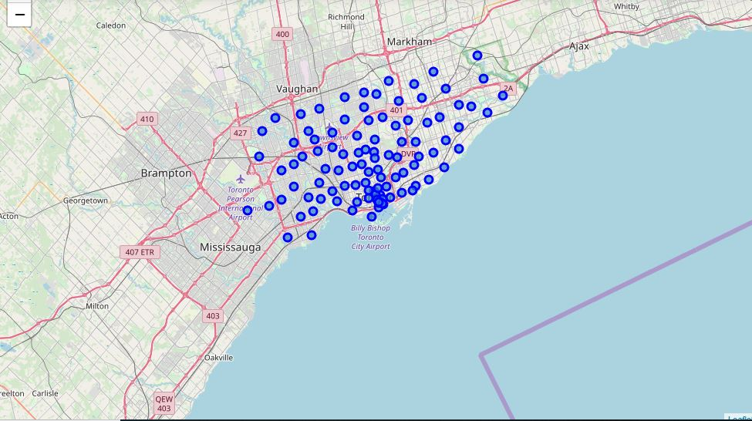
Map of Toronto city with all its neighbourhoods marked on the map:

Slide 6
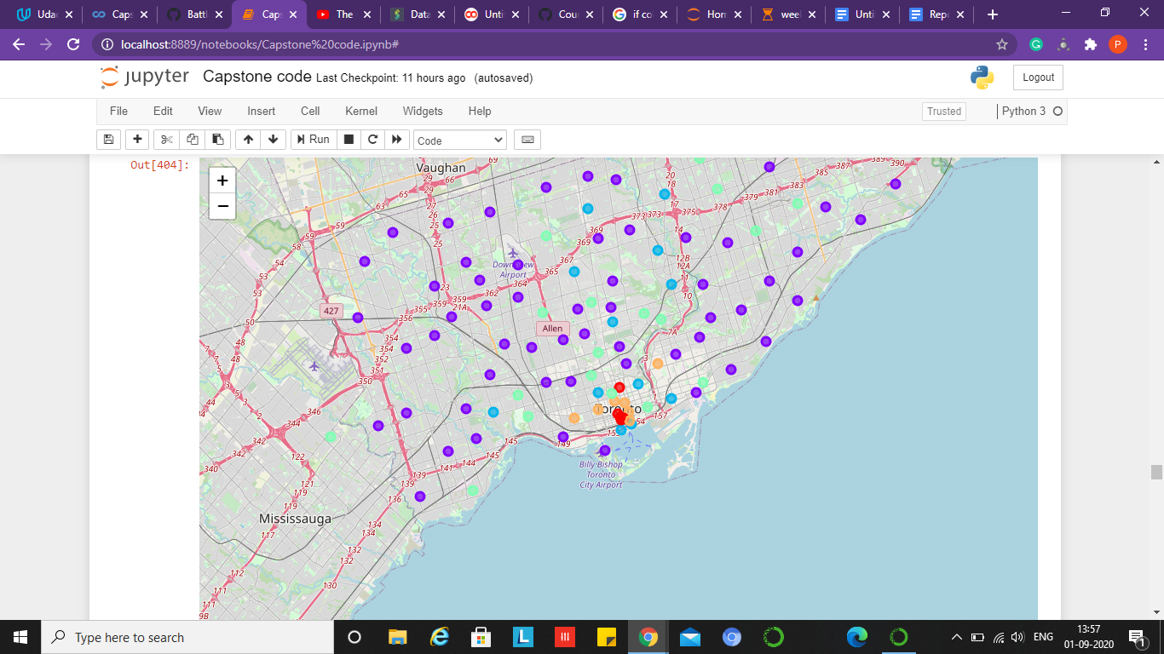
Map after assigning clusters to each neighbourhood:
Different colour of neighbourhoods represent belonging to a different cluster.

Slide 7
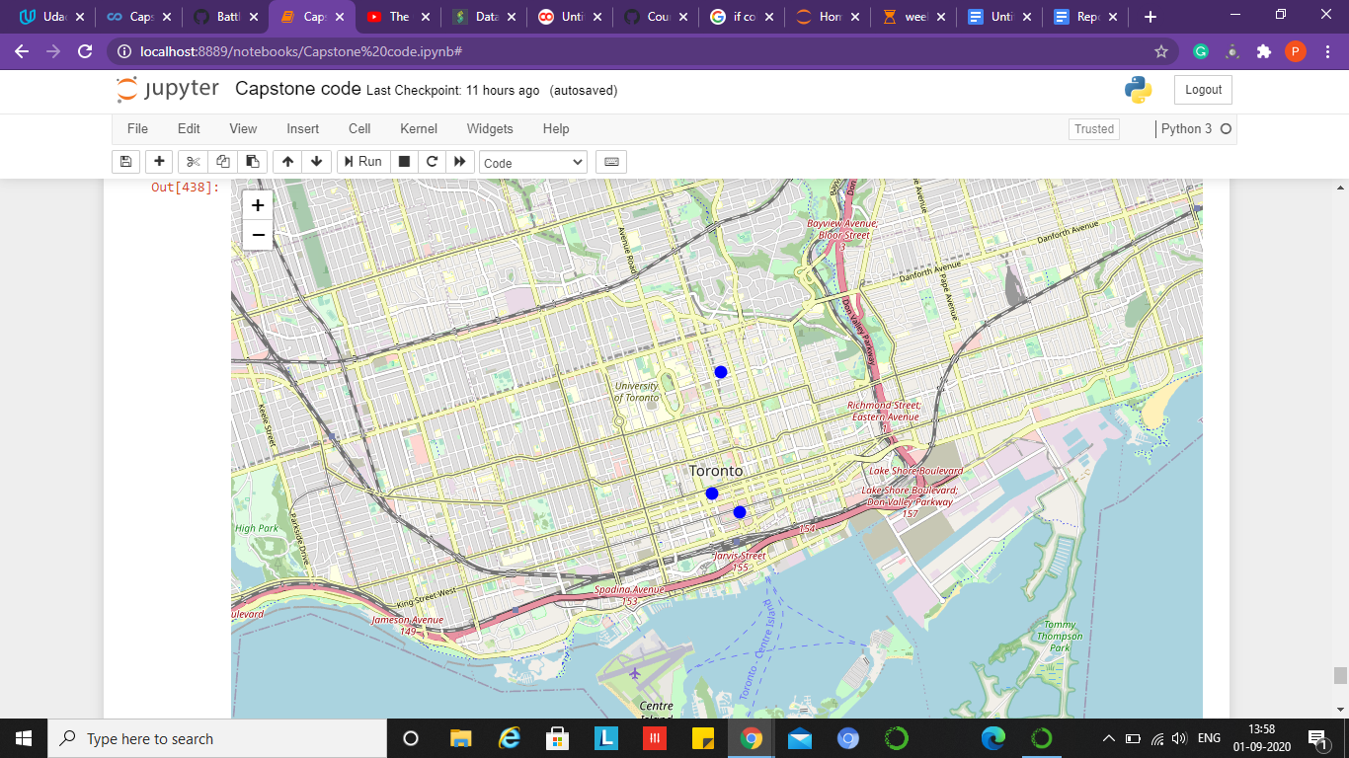
Map representing final 3 neighbourhoods suitable for restaurant opening:
The 3 neighbourhoods are depicted by 3 blue dots in the above map.

Slide 8
Conclusion
Purpose of this project was to identify neighbourhoods in Toronto which have low number of restaurants in order to aid stakeholders in narrowing down the search for optimal location for a new restaurant.
By calculating restaurant density distribution from Foursquare data we have first identified the most common nearby venues of each neighbourhood.
Then with the help of clustering techniques and further analysis we were able to narrow down our analysis to 3 neighbourhoods which were good for opening up a new restaurant.
This concludes this project of Battle of Neighbourhoods.

